Slide 1
Exploring Long-Term Temperature Forecasts CNNs to Attention-Enhanced ConvLSTMs
Dorian Boucher
-
49004563
Johannes Gungaard
-
49004571
Philipp Peter
-
49004549
Thomas Renaud
-
49004578
Deep Learning AIGS538

Slide 2

Importance of Temperature Forecasting
Sectoral Relevance:
Critical for agriculture, energy, and transportation, reflecting direct impacts on daily operations and long-term planning
Climate Change Indicator:
Temperature trends as a primary marker for studying and responding to global climate shifts
Localized Impact:
Advanced modeling for accurate regional forecasts, crucial for effective community and ecosystem management
[1]
Deep Learning AIGS538

Slide 3
Preparing Weather Data as Time Series
Data Collection:
ERA5 Reanalysis data set
1940 to present
Extraction:
Region: South Korea, 378 Stations
[34°N, 38°N] & [125°W, 130°E]
each month averaged over 5 days
1st 7th 13th 19th 25th
$$\overline{month}$$
Deep Learning AIGS538

Slide 4
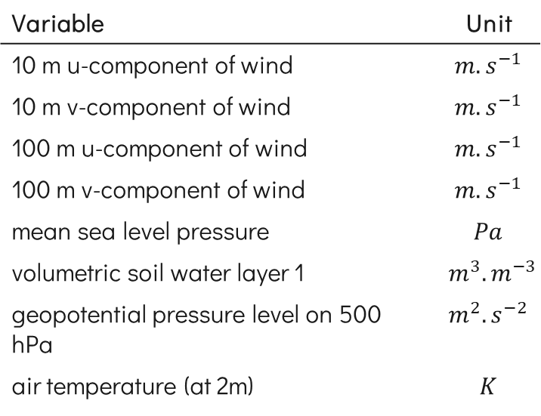
Preparing Weather Data as Time Series
Variable | Unit
10 m u-component of wind | $$m.s^{−1}$$
10 m v-component of wind | $$m.s^{−1}$$
100 m u-component of wind | $$m.s^{−1}$$
100 m v-component of wind | $$m.s^{−1}$$
mean sea level pressure | $$Pa$$
volumetric soil water layer 1 | $$m^{3}.m^{−3}$$
geopotential pressure level on 500 hPa | $$m^{2}.s^{−2}$$
air temperature (at 2m) | $$K$$
Data Collection:
ERA5 Reanalysis data set
1940 to present
Extraction:
Region: South Korea, 378 Stations
[34°N, 38°N] & [125°W, 130°E]
each month averaged over 5 days
Feature Selection:
8 features in total from Fister et al. [2]
1st 7th 13th 19th 25th
$$\overline{month}$$
Deep Learning AIGS538

Slide 5
Preparing Weather Data as Time Series
F1
F2
F3
F4
F5
F6
F7
F8
Data Collection:
ERA5 Reanalysis data set
1940 to present
Extraction:
Region: South Korea, 378 Stations
[34°N, 38°N] & [125°W, 130°E]
each month averaged over 5 days
Feature Selection:
8 features in total from Fister et al. [2]
1st 7th 13th 19th 25th
$$\overline{month}$$
Deep Learning AIGS538
Notes:
NO CLICK!!!

Slide 6
Preparing Weather Data as Time Series
F1
F2
F3
F4
F5
F6
F7
F8
F1
F2
F3
F4
F5
F6
F7
F8
F1
F2
F3
F4
F5
F6
F7
F8
F1
F2
F3
F4
F5
F6
F7
F8
F1
F2
F3
F4
F5
F6
F7
F8
Data Collection:
ERA5 Reanalysis data set
1940 to present
Extraction:
Region: South Korea, 378 Stations
[34°N, 38°N] & [125°W, 130°E]
each month averaged over 5 days
Feature Selection:
8 features in total from Fister et al. [2]
1st 7th 13th 19th 25th
$$\overline{month}$$
Deep Learning AIGS538
Notes:
NO CLICK!!!

Slide 7
Preparing Weather Data as Time Series
F1
F2
F3
F4
F5
F6
F7
F8
F1
F2
F3
F4
F5
F6
F7
F8
F1
F2
F3
F4
F5
F6
F7
F8
F1
F2
F3
F4
F5
F6
F7
F8
F1
F2
F3
F4
F5
F6
F7
F8
Data Collection:
ERA5 Reanalysis data set
1940 to present
Extraction:
Region: South Korea, 378 Stations
[34°N, 38°N] & [125°W, 130°E]
each month averaged over 5 days
Feature Selection:
8 features in total from Fister et al. [2]
1st 7th 13th 19th 25th
$$\overline{month}$$
Deep Learning AIGS538

Slide 8
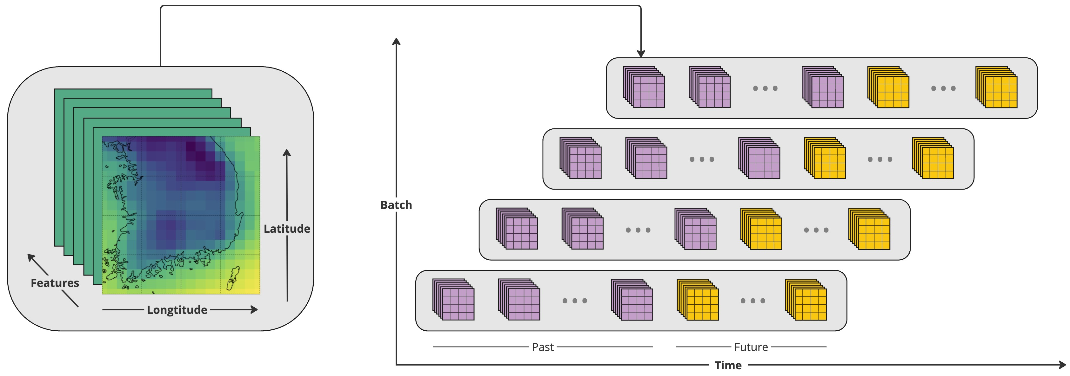
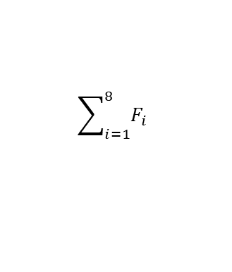
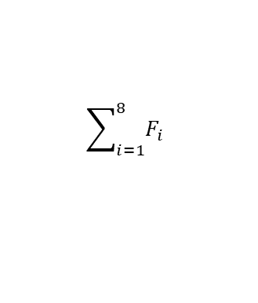
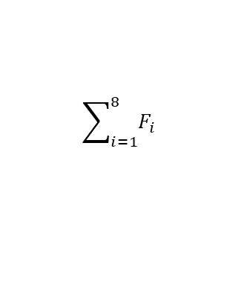
Preparing Weather Data as Time Series
Data Splitting:
70:20:10 (Train:Validation:Test)
$$\sum_{i=1}^{8}{F_{i}}$$
$$\sum_{i=1}^{8}{F_{i}}$$
$$\sum_{i=1}^{8}{F_{i}}$$
$$\sum_{i=1}^{8}{F_{i}}$$
$$\sum_{i=1}^{8}{F_{i}}$$
1st 7th 13th 19th 25th
$$\overline{month}$$
Deep Learning AIGS538

Slide 9
Preparing Weather Data as Time Series
Data Splitting:
70:20:10 (Train:Validation:Test)
Time-Window
6 years
2 years
Deep Learning AIGS538

Slide 10
Preparing Weather Data as Time Series
Data Splitting:
70:20:10 (Train:Validation:Test)
Time-Window
Deep Learning AIGS538

Slide 11
!!! RELATED WORK!!! Maybe??
One slide should be enough
Sources can continue with [3]

Slide 12
Approaches
CNN
[BS, TS, C, H, W]
|
Convolution
|
ReLu
|
Max Pooling
|
Dense1
|
Dense2
|
[BS, FS, H, W]
BS: Batch Size, TS: Time-steps, C: Features, H: Height, W: Width, FS: Future-steps
Deep Learning AIGS538

Slide 13
Approaches
ConvLSTM
CNN
[BS, TS, C, H, W]
|
Convolution
|
ReLu
|
Max Pooling
|
Reshape for LSTM
|
LSTM
|
Dense1
|
Dense2
|
[BS, FS, H, W]
[BS, TS, C, H, W]
|
Convolution
|
ReLu
|
Max Pooling
|
Dense1
|
Dense2
|
[BS, FS, H, W]
BS: Batch Size, TS: Time-steps, C: Features, H: Height, W: Width, FS: Future-steps
Deep Learning AIGS538

Slide 14
Approaches
ConvLSTM - Attention
ConvLSTM
CNN
[BS, TS, C, H, W]
|
Convolution
|
ReLu
|
Max Pooling
|
Reshape for LSTM
|
LSTM
|
ProbSparse Attention
|
Dense1
|
Dense2
|
[BS, FS, H, W]
[BS, TS, C, H, W]
|
Convolution
|
ReLu
|
Max Pooling
|
Reshape for LSTM
|
LSTM
|
Dense1
|
Dense2
|
[BS, FS, H, W]
[BS, TS, C, H, W]
|
Convolution
|
ReLu
|
Max Pooling
|
Dense1
|
Dense2
|
[BS, FS, H, W]
BS: Batch Size, TS: Time-steps, C: Features, H: Height, W: Width, FS: Future-steps
Deep Learning AIGS538

Slide 15
Approaches
ConvLSTM - Attention
ConvLSTM
CNN
[BS, TS, C, H, W]
|
Convolution
|
ReLu
|
Max Pooling
|
Reshape for LSTM
|
LSTM
|
ProbSparse Attention
|
Dense1
|
Dense2
|
[BS, FS, H, W]
[BS, TS, C, H, W]
|
Convolution
|
ReLu
|
Max Pooling
|
Reshape for LSTM
|
LSTM
|
Dense1
|
Dense2
|
[BS, FS, H, W]
[BS, TS, C, H, W]
|
Convolution
|
ReLu
|
Max Pooling
|
Dense1
|
Dense2
|
[BS, FS, H, W]
BS: Batch Size, TS: Time-steps, C: Features, H: Height, W: Width, FS: Future-steps
Deep Learning AIGS538
Notes:
NO CLICK!!!

Slide 16
Approaches
ConvLSTM - Attention
[BS, TS, C, H, W]
|
Convolution
|
ReLu
|
Max Pooling
|
Reshape for LSTM
|
LSTM
|
ProbSparse Attention
|
Dense1
|
Dense2
|
[BS, FS, H, W]
ProbSparse Attention
[Query, Key, Value]
|
Sampling & Slicing
|
Batch Matrix Multiplication
|
Query Sparsity Measurement
|
Top-u Queries
|
Attention Scores Calculation
|
Softmax Normalization
|
[Attention Output, Attention Probabilities]
BS: Batch Size, TS: Time-steps, C: Features, H: Height, W: Width, FS: Future-steps
Deep Learning AIGS538

Slide 17
Approaches
ConvLSTM - Attention
ConvLSTM
CNN
[BS, TS, C, H, W]
|
Convolution
|
ReLu
|
Max Pooling
|
Reshape for LSTM
|
LSTM
|
ProbSparse Attention
|
Dense1
|
Dense2
|
[BS, FS, H, W]
[BS, TS, C, H, W]
|
Convolution
|
ReLu
|
Max Pooling
|
Reshape for LSTM
|
LSTM
|
Dense1
|
Dense2
|
[BS, FS, H, W]
[BS, TS, C, H, W]
|
Convolution
|
ReLu
|
Max Pooling
|
Dense1
|
Dense2
|
[BS, FS, H, W]
BS: Batch Size, TS: Time-steps, C: Features, H: Height, W: Width, FS: Future-steps
Deep Learning AIGS538
Notes:
NO CLICK!!!

Slide 18
Comparative Performance
ConvLSTM - Attention
ConvLSTM
CNN
0.2383
0.2003
0.4105
Mean Absolute Error
1.5355
1.4153
2.6347
Mean Absolute Percentage Error
0.2948
0.2492
0.5224
Root Mean Square Error
Deep Learning AIGS538

Slide 19
Comparative Performance
ConvLSTM - Attention
ConvLSTM
CNN
0.2383
0.2003
0.4105
Mean Absolute Error
1.5355
1.4153
2.6347
Mean Absolute Percentage Error
0.2948
0.2492
0.5224
Root Mean Square Error
Deep Learning AIGS538

Slide 20
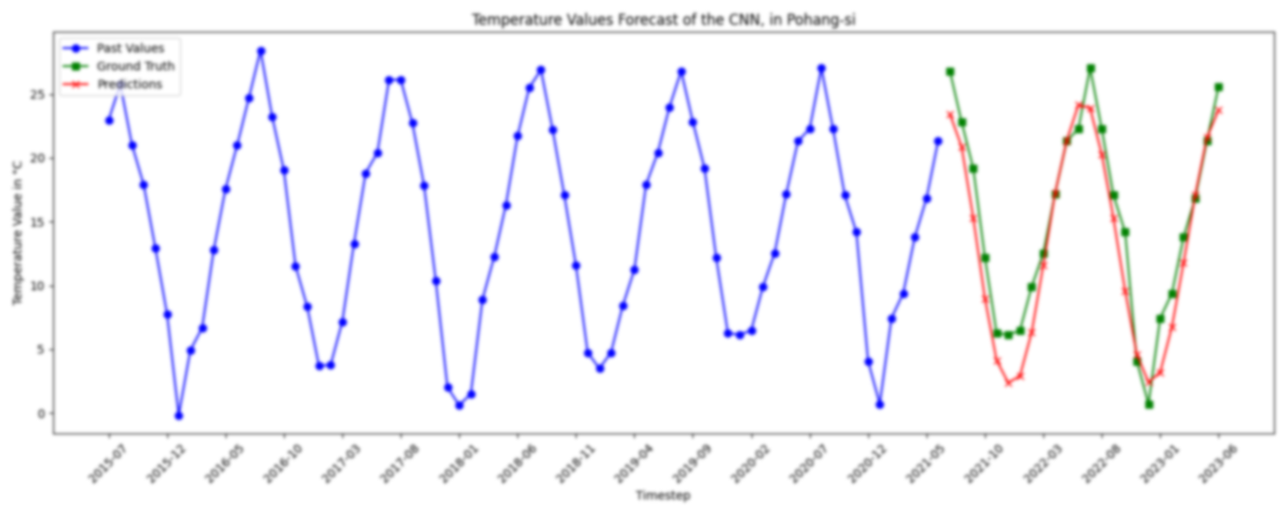
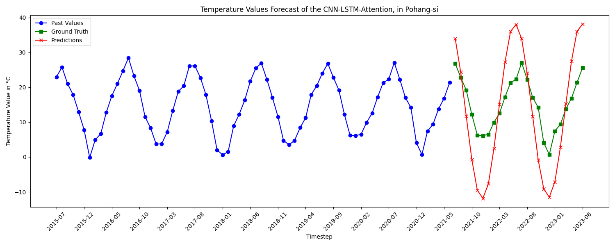
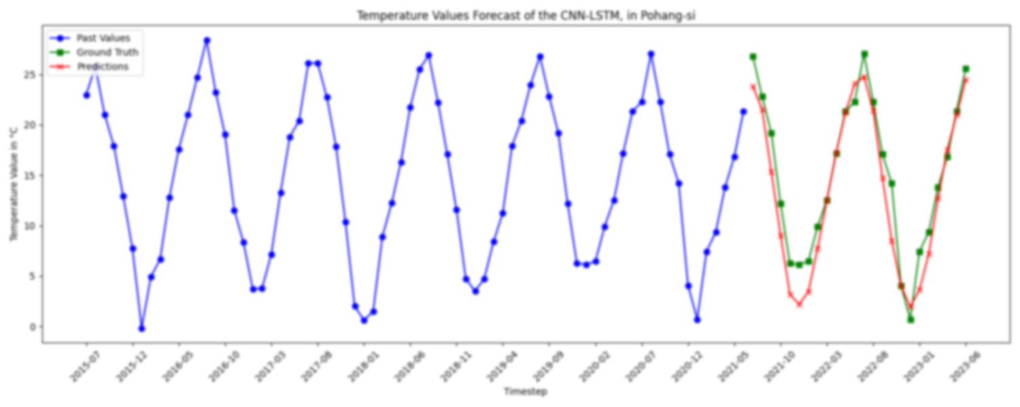
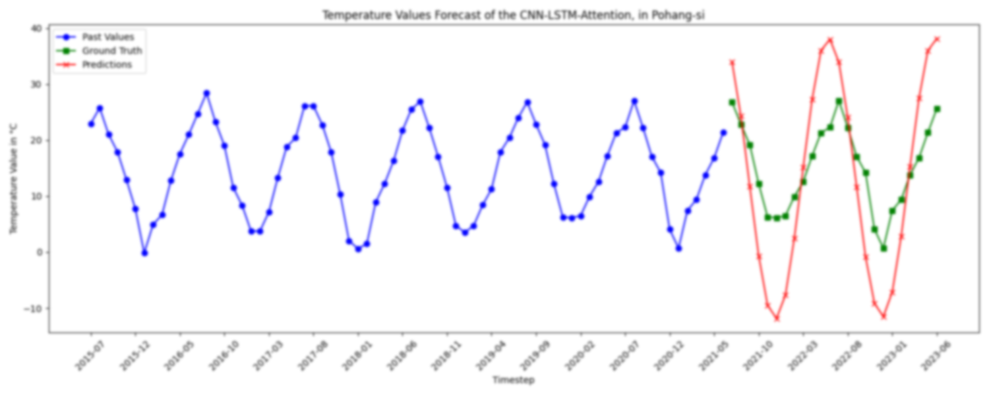
Comparative Performance
…
Deep Learning AIGS538

Slide 21
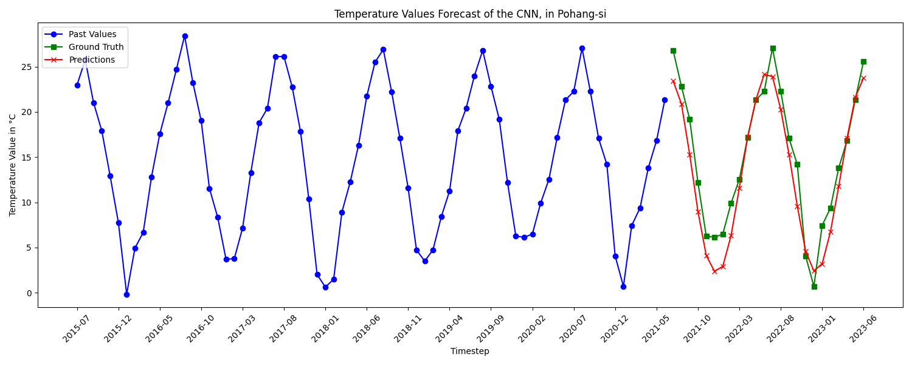
Comparative Performance
…
CNN
Deep Learning AIGS538

Slide 22
Comparative Performance
…
Deep Learning AIGS538
Notes:
NO CLICK!!!

Slide 23
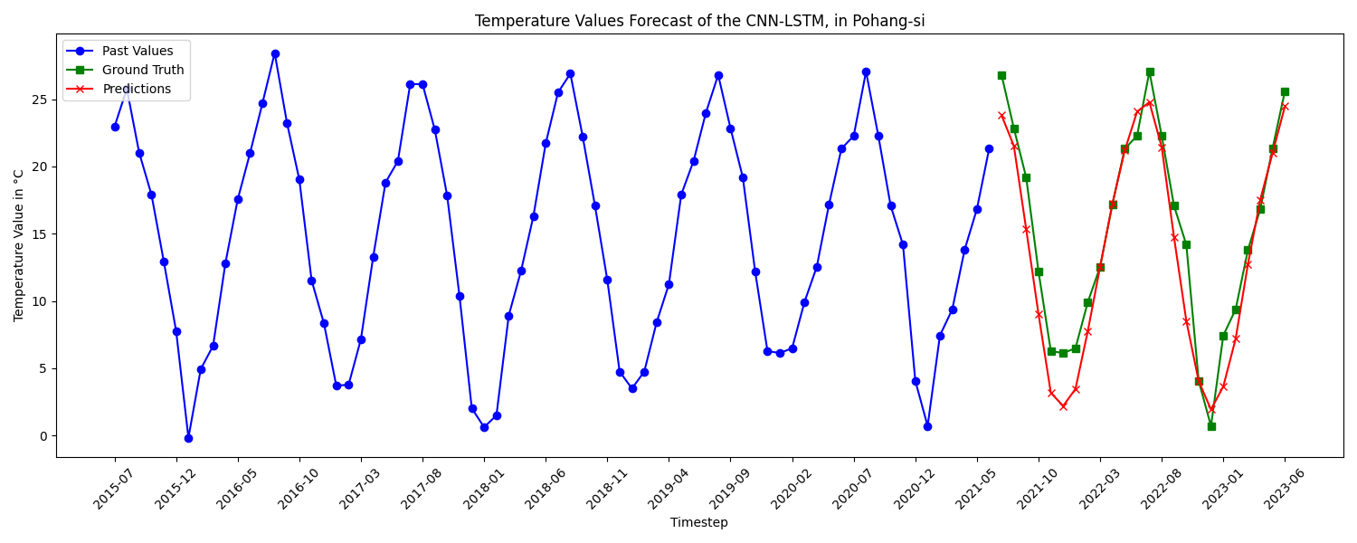
Comparative Performance
…
ConvLSTM
Deep Learning AIGS538

Slide 24
Comparative Performance
…
Deep Learning AIGS538
Notes:
NO CLICK!!!

Slide 25
Comparative Performance
…
ConvLSTM –
Attention
Deep Learning AIGS538

Slide 26
Comparative Performance
…
Deep Learning AIGS538

Slide 27
Conclusion
Model Performance Insights
Conv LSTM Superiority:
Lowest errors in MAE, MAPE, and RMSE, indicating high accuracy in long-term temperature forecasting
Basic Convolutional Efficacy:
More errors than Conv LSTM, showing the benefits of temporal processing in LSTMs
Attention Mechanism Setback:
Underperformance suggests complexity and potential overfitting, necessitating model refinement
Deep Learning AIGS538

Slide 28
Conclusion
The use of compact models for extended temperature forecasting represents a practical advancement in the field of climate modeling, offering a more efficient approach to understanding and anticipating climatic trends over longer periods.
Thank you for listening
Deep Learning AIGS538

Slide 29
References
[2] Fister, D., Pérez-Aracil, J., Peláez-Rodríguez, C., Del Ser, J., and Salcedo-Sanz, S., "Accurate long-term air temperature prediction with Machine Learning models and data reduction techniques," in Applied Soft Computing, vol. 136, pp. 110118, 2023. DOI: 10.1016/j.asoc.2023.110118. [Online]. Available: https://www.sciencedirect.com/science/article/pii/S1568494623001369.
Deep Learning AIGS538
Notes:
NO CLICK!!!

Slide 30
Image References
[1] Treescape, "Global Warming: Unveiling the Unsettling Consequences," Treescape Planet, June 2023. [Online]. Available: https://treescapeplanet.org/global-warming-unveiling-the-unsettling-consequences/. [Accessed Dec. 10, 2023].
Deep Learning AIGS538

